Slide 1

Introduction to Python
CISC 160
Data Structures
Brian Grey

Slide 2
What are we doing today?
Introduction to Python
Okay…more of a review
Interpreters versus Compilers
Objects & Variables
Dynamic Typing
Built-In Classes
Memory Management
Expressions & Operators
Flow Control
Comprehension Syntax

Slide 3
Python: An Interpreted Language
Python is a high-level language
This means that code is generated in human-understandable language and translated to lower languages
Assembler & Machine Code
All high level languages exist because programming in low level languages is, and this is a technical term, a pain in the butt
Assembler manipulates the Fetch-Decode-Execute cycle
Machine Code is literally binary
Code is very fast
Code is machine specific

Slide 4
Python: An Interpreted Language
Two Ways to Convert:
Compiler & Interpreter
Compilers run several syntactical and semantical checks, converting the high-level code to specific machine code
Code is very fast
Code is machine specific
Interpreters do a quick syntactical check and then run line by line
Code is less fast
Code is very portable

Slide 5
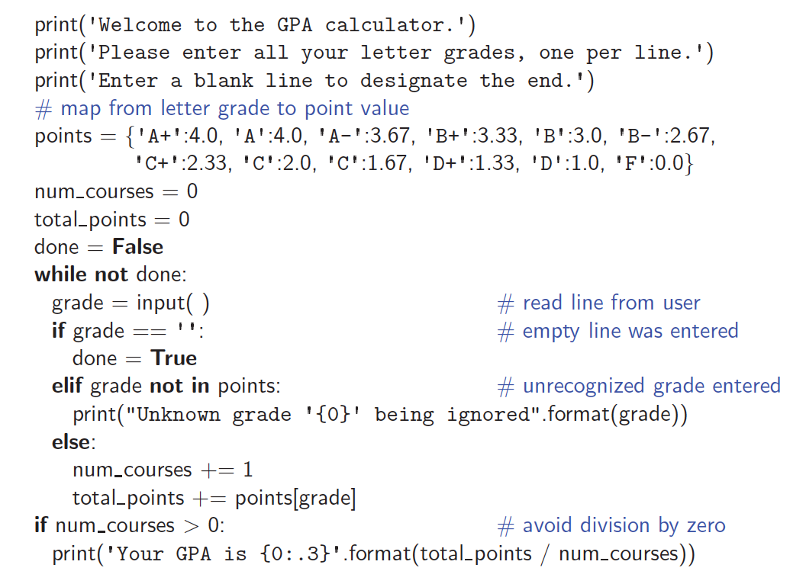
Example Program
grader.py
From Goodrich, Tamassia, Goldwasser (2013)

Slide 6
Object-Oriented Python
All data and data types in Python are objects
Objects can be thought of and treated as literal things in your code
Objects have state and behavior
State defines that attributes of an object
Behavior defines what an object can do
Examples:
int, float, and str are all built-in object types (classes)
State is the value that it holds
Behavior are methods that can be called (str.trim())

Slide 7
Objects, Variables, Identifiers & Memory
How do store data in Python?
<identifier> = <value>
Example: num_courses = 0
How does this work behind the scenes?
A block in memory is allocated and given the identifier num_courses
This value can be accessed, changed, or used by invoking the identifier num_courses

Slide 8
Objects, Variables & Type
What is type?
The kind of object
Such as…
int
float
str
Python is dynamically-typed
Variables do not have to be declared as a specific type
Variables can change type depending on the value assigned

Slide 9
Creating Objects
Also called instatiation
Creating an instance of an object
Two options:
Calling a constructor
Constructors have the name of the object/class type
x = int(3.0)
Literal form
Using a literal value for defining the object
x = 3

Slide 10
Methods
Actions an object can take
Typically based on the state of the object
Methods are invoked or called by referencing the name
Uses the dot operator (.)
data = “hello” data.append(“!”)
Different types of objects can have different methods
Different types of objects can have the methods with the same names that do different things

Slide 11
Immutable Classes
bool, int, float, str, tuple, and frozenset are immutable
Cannot be changed
What happens when variables are given new variables?
How is this different for mutable classes?
list, set, dict
How can we tell if two variables are the same?
== versus is

Slide 12
Quick Discussion of Built-In Types
Examples:
bool: True or False
int: 5 or -10
float: 3.5, -10.4, or 0.0
str: “string example” or ‘another example’
list: [] or [‘a’, 23, 4.3]
tuple: () , (‘a’, 23, 4.3), or (‘a’,)
set: set() , {‘a’, 23, 4.3}, or {‘a’}
dict: {1:‘a’, ‘b’:4.3, 12:“sure!”}

Slide 13
List Comprehension Syntax
Syntax to create a list programmatically in a single line
Think: combo of a literal list and for loop
Syntax:
<variable> = [<value> for <var> in <iterable>]
The for loop is essentially a standard for loop
The list is constructed iteratively and can be saved
Examples:
list1 = [i for i in range(1, 11)]
list2 = ["a"*x for x in [1,5,6,2,1,4]]

Slide 14
Up Next
Assignment 01
Read Chapter 2
QUIZ NEXT CLASS!

